Slide 1
Using ICT to Explore the 1916 Rising
Venue:
Presenter:
© PDST Technology in Education 2015/2016
This work is made available under the terms of the Creative Commons Attribution Share Alike 3.0 Licence http://creativecommons.org/licenses/by-sa/3.0/ie/. You may use and re-use this material (not including images and logos) free of charge in any format or medium, under the terms of the Creative Commons Attribution Share Alike Licence.
‹#›

Slide 2
Objectives
To discover a range of online resources that can be used to enhance teaching and learning for the anniversary of the 1916 Rising.
To demonstrate how relevant digital literacy skills in finding and selecting information can be developed.
To explore how children can use ICT to present their own historical findings.
Notes:
Overview of course objectives to be provided to all participants.

Slide 3
ICT and the History Curriculum
“..the internet can give children access to a vast range of pictorial, film and other sources which can greatly enrich children’s historical understanding.”
“Information and communication technologies also facilitate children’s presentation of their own historical findings”
(Primary History Curriculum, P.11)
Notes:
These 2 quotes are taken directly from the Primary History Curriculum and highlight the positive role that ICT can play in teaching and learning about history.

Slide 4
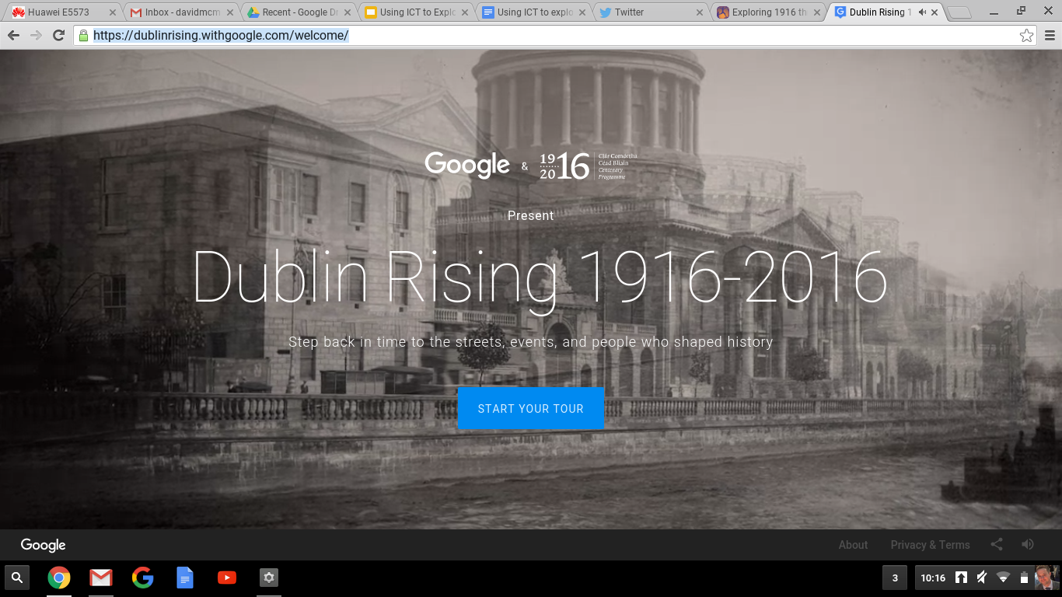
https://dublinrising.withgoogle.com/welcome/

Slide 5
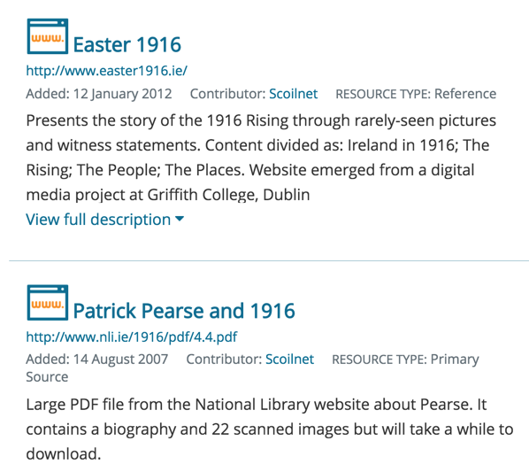
Scoilnet Resources
There are many resources relating to the 1916 Rising accessible from the Scoilnet website. There is a new website all about the Irish Flag and its relevance around 1916.
There are many other resources pertaining to 1916 which can be found by performing a search for “1916” from the Scoilnet homepage.
Task: Take some time to explore resources from Scoilnet
Notes:
Tutor to demonstrate the New Irish Flag website (https://www.scoilnet.ie/irishflag/) and go through the main features with the participants. Give them time to do some further exploring of the site.
Show participants how to search for items on Scoilnet by visiting www.scoilnet.ie and typing “1916” into the search bar. Show how results can be filtered by class level, etc. Give participants some time to explore the resources relating to 1916

Slide 6
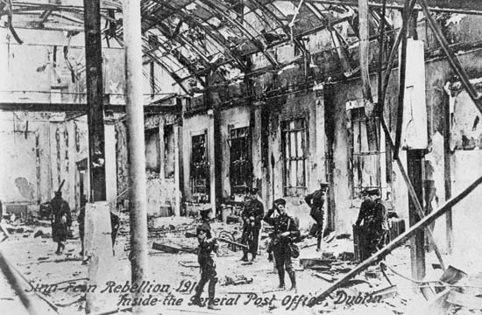
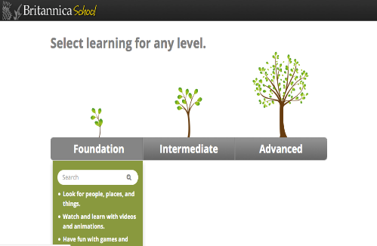
Britannica Schools
The three levels of learning in Britannica School
Foundation
Intermediate
Advanced
Group Task: Using Britannica School Foundation Level perform a search for “Easter Rising”. Can you read this article at two different levels of difficulty?
Notes:
Navigate to www.scoilnet.ie
Navigate to Britannica
Demonstrate:
Three levels
Foundation level – different ways to navigate – teacher and student levels
Intermediate level – Upper Primary/lower post primary
Articles, media, biographies, further interactive resources
Advanced – Post Primary
Tutor demonstrates features below
Log in
Articles
Media
Animal Kingdom
World Atlas
Compare counties
Learning Games
My content
Increase font
Read text aloud
Favourite
Print and email functions
Reading level
Teacher options - curriculum

Slide 7
Britannica School
Key Classroom Features
Read Aloud
Decrease / Increase Font
Double Click Definition
Adjust Reading Level
Related Reading
Teacher Page
http://school.eb.co.uk/levels
Notes:
Give adequate time to participants to investigate the key features listed in the slide above. Each of these features can be used to accommodate a range of learning styles and needs.

Slide 8
Educational Videos on the Rising
There are many educational videos about the 1916 Rising available online but they can be hard to source.
Three sites where content is available ,including actual footage of the Rising, are the RTE Archives, YouTube and Vimeo
Task: Find a video that you will show to your class in advance of the anniversary.
Notes:
There are plenty of videos online about the 1916 Rising but it can often be difficult to find relevant ones. We’ve selected a few examples that might be suitable for classroom use.
All of the images in the slide can be clicked on to bring you to the resource.
RTE Archives - the first resource will bring you to the search term “Rising” in the RTE Archive website. There are many videos and programmes available here.
YouTube - there are many videos on YouTube about the Rising. Clicking on the image will bring you into the account of the user The Rising. Here you will find some real footage from the Rising. This account appears to be about a movie but has some old footage also. At this point some participants may state that YouTube is blocked in their school. Some schools have chosen to have YouTube unblocked but have protection through their Acceptable Usage Policy. For further information about content filtering and having YouTube unblocked visit: http://www.pdsttechnologyineducation.ie/ga/Technology/Schools-Broadband/Content-Filtering/Content-Filtering-for-Schools.html
Vimeo also has videos about the Rising. Clicking on the image in the slide will bring you to the search term 1916 Rising where you will see some suitable videos.
Give participants time to look at some of the videos and select what they will use in the classroom.

Slide 9
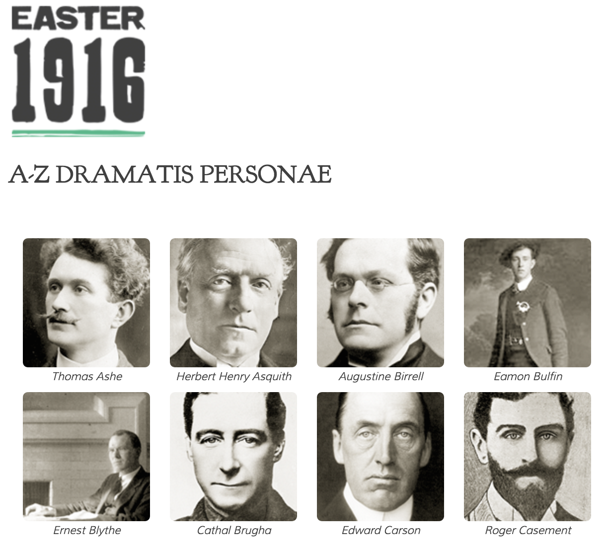
The People of the Rising
Task: Visit the resource and read about 3 important people that featured in the 1916 Rising?
Are any of the people associated with your locality?
Can children identify buildings or roads named after anyone?
Notes:
Visit the resource: http://www.easter1916.ie/index.php/people/a-z/ and explore the content. Give participants time to read about 3 different people associated with the Rising.
Possible classroom activities:
Have children look at a map of the local town to see if any roads/streets/buildings have been named after the people.
Match the names of the individuals to the names of the train stations in Ireland

Slide 10
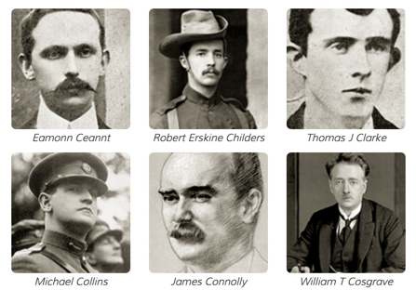
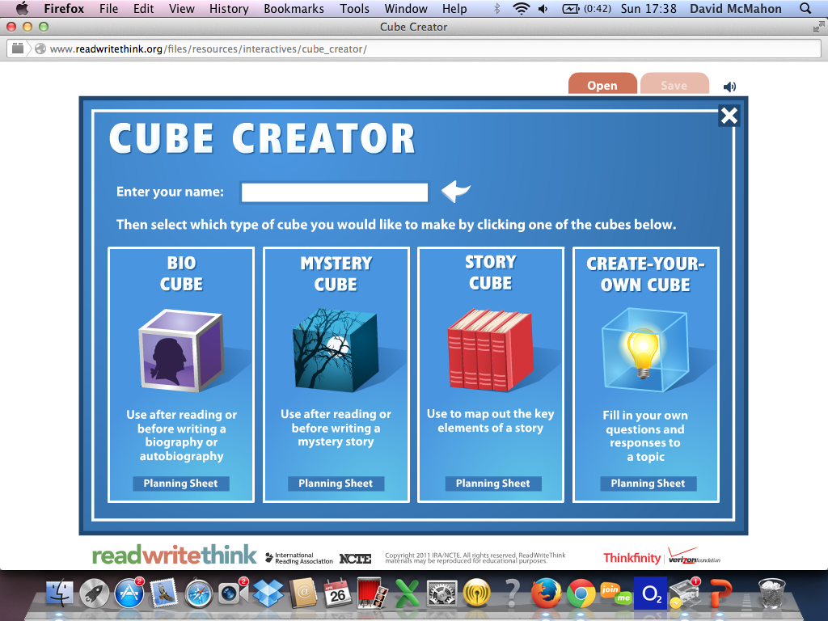
Task: Bio Cube
Using the Bio Cube from ReadWriteThink’s Cube Creator can you create a report on a prominent individual who was part of the 1916 Rising.
Are there other ways the Cube Creator could be used to facilitate learning about the 1916 Rising?
Notes:
Tutor to introduce participants to the Cube Creator from ReadWriteThink (http://www.readwritethink.org/files/resources/interactives/cube_creator/) by stepping them through the process of creating a Bio Cube. Ask participants to select an individual from the previous resource and create a Bio Cube about their life.
If a printer is present at your venue it would be a good opportunity to create a printed cube. Alternatively, you could have a printed version with you to demonstrate to the group.
If time permits you could demonstrate the other types of cube that are available and have a discussion on ways that they could be used in the classroom. Also, it is a good opportunity to demonstrate some of the other interactive resources that are available on the ReadWriteThink website: http://www.readwritethink.org/classroom-resources/student-interactives/

Slide 11
Copyright
Covers images, audio and completed work of pupils
Copyright and publishing policies should be covered in your school’s Acceptable Use Policy
ClipArt and Images found online will be copyright protected
Creative Commons Licensing allows users to specify how material can be used. It does not mean giving up copyright, instead it means offering some of your rights to any member of the public under certain conditions.
Notes:
Cover key features as outlined above in the use of images and the need to respect copyright.
This is potentially important if schools decide to make any publications about the 1916 Rising. They need to be mindful of where images are sourced as they could potentially be using images without permission. This would arise if a school were to produce a piece of material that was available publically e.g. magazine, book, post on a website or blog, a PowerPoint put up on a website, etc.

Slide 12
Google Image Search
Google Image Search offers a great range of images
Can you reuse all of them in a document or presentation?
There are copyright issues
Possibility of contacting the owner of the image
Notes:
Google Image search is a great way of accessing images online but there are copyright issues if you are to reuse the image in a document or presentation. Some images will carry a copyright, some are free for use and others are undefined. If you use an image which is copyrighted or is undefined you could be infringing on copyright. If you find an image you really like there is the possibility of contacting the owner to seek permission to reuse the image.
Perform a search for the term “Easter Rising” in Google Images. It is possible that if you take the images and reuse them for your own purposes that you could be infringing on someone’s copyright. Now change the search by selecting Search Tools -> Usage Rights -> Labeled for reuse with modification. You will probably see a smaller collection of images but all of the images can be used safely without infringing on any person’s copyright.
Task: Compare a traditional image search with a search where the usage rights have been changed.

Slide 13
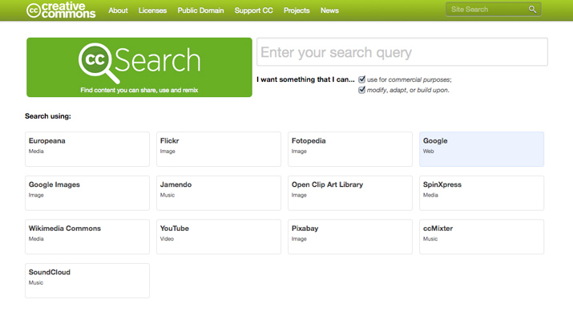
Creative Commons Image Search
Use Creative Commons Image search to look for copyright free images from a range of sources.
Task: Use Creative Commons to search Flickr and Google Images for the terms relating to the Rising e.g.“1916 Rising.” Save 6 of these images to a folder.
Notes:
The Creative Commons search facility allows you to search a range of sites including Wikipedia, Flickr and Google Images for pictures that can be copied and edited freely without any copyright infringement.
There is another website called http://www.photosforclass.com/ that offers the same functionality. If time permits you could show this also
Tutor first to show participants how to create a folder called “1916 Rising” . Tutor then to demonstrate how to save images from both Google Images and Flickr to this folder. Participants will need these images for the activity on the next slide.

Slide 14
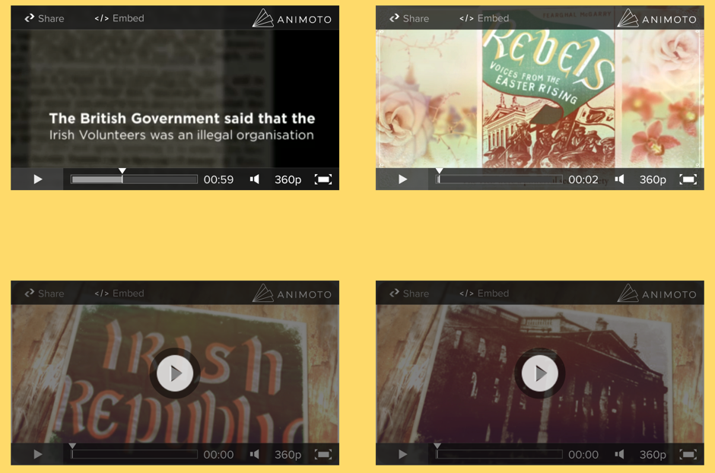
Digital Storytelling
Text, Image & Audio
Look at these Animoto videos created by Scoil Mhicil Naofa, Galmoy.
Task: Register for your own Animoto account
Notes:
Tutor to visit the webpage of Galmoy N.S. (http://www.smngalmoy.com/easter-rising-project.html) and show one of the Animoto videos created by students to the group.
Explain that Animoto is a web tool that can be used for digital storytelling. Users can add photos, videos, images from the web and music to create their own digital stories. Animoto provides templates that can be used and simplifies the process of creating a digital story. Once the story is finished it can be downloaded as a video, emailed and embedded on websites and blogs. This allows children to reach a wider audience with their stories.
*Allow participants adequate time to create their own teacher account on www.animoto.com/
Instructions for setting up an Animoto Account:
1. Sign up with your email
2. Take “Dashboard” out of url and type in /Education. (Business/Education appears)
3. Click on "Learn More" , blue writing in centre of page.
4. Click on "Apply now". Fill in details but do not use a gmail address for your school.
No need to fill blog details.
5. Copy your promo code.
7. Go back to your Animoto home page (take /Business/Education out of url)
8. Click on “Account” on left panel
9. Paste your code into the box.
10. Click on "Submit code".
You now have an Animoto account for a year. Can reapply next year.

Slide 15
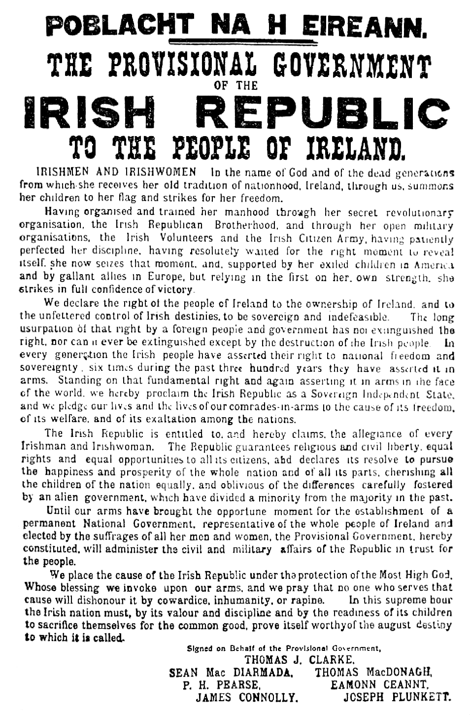
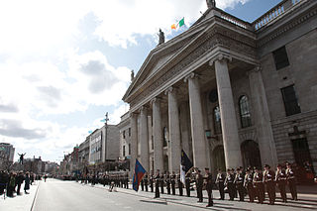
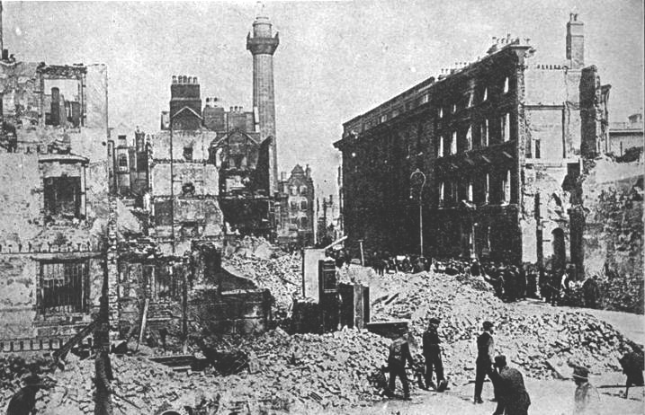
1916 Digital Story Task
Use Animoto and the images you have already saved to create a digital story about the 1916 Rising.
N.B. The National Library have some photos on Flickr that can be used.
Notes:
This task will take some time and participants will probably need some assistance. Give plenty of time and if people complete their videos share them with the group.
The National Library photos can be accessed here: https://www.flickr.com/photos/nlireland/albums/72157628305129213. While they do not have a Creative Commons licence it states that there is “No known Copyright Restrictions”

Slide 16
Irish Times Guide
The Irish Times have produced a guide about the 1916 Rising for teachers and children.
Task 1: Scroll down to the Interactive Proclamation and explore the resource.
Task 2: Identify an article on the site that you could use with your class.
Notes:
Tutor to demonstrate the website to the group and highlight areas of interest. Give participants time to try out the interactive proclamation and to find other resources for their class.

Slide 17
Role of Women in the Rising
The role of Countess Markievicz
Footage of the Rising
Witness Statements

Slide 18
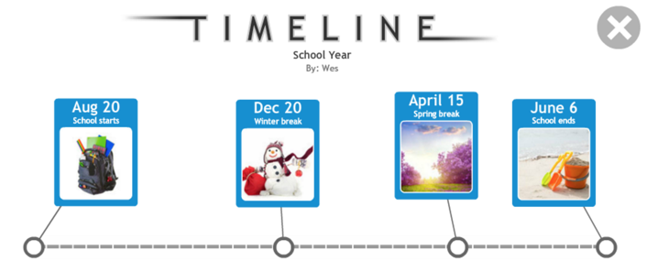
Task: Easter Rising Timeline
Using the Irish Times blow-by-blow guide to the Easter Rising article and any other information you have learned can you create a timeline of the major events that occurred around Easter 1916?
ReadWriteThink have an easy to use interactive timeline. Make sure to include images in your timeline.
Notes:
Tutor needs to demonstrate how to create a timeline using the ReadWriteThink resource (http://www.readwritethink.org/classroom-resources/student-interactives/timeline-30007.html) . The Irish Times article could be useful to assist participants, it can be accessed here: http://www.irishtimes.com/culture/heritage/1916-schools/a-blow-by-blow-guide-to-the-easter-rising-1.2353931

Slide 19
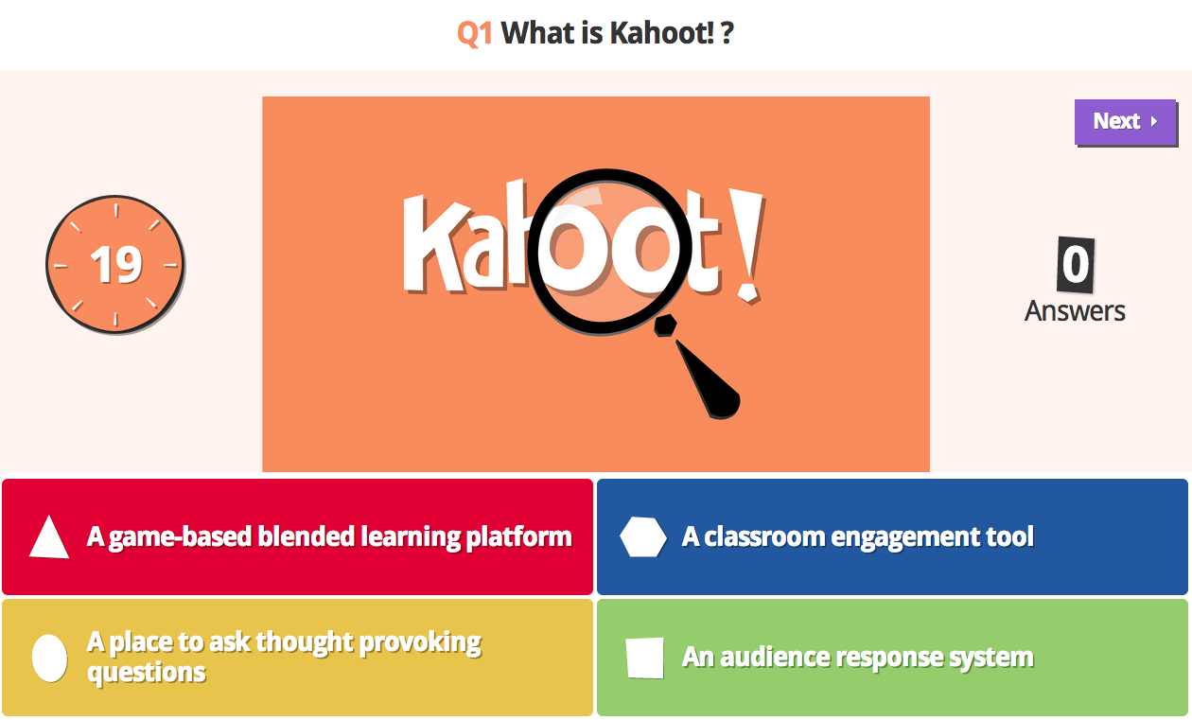
Kahoot for Assessment
http://getkahoot.com/ - Teacher
http://kahoot.it - Student
Notes:
Introduce Kahoot by asking the group to participate in a sample quiz on the 1916 Rising. This quiz has been created by a Mister Keogh. There are many Irish teachers now making Kahoot quizzes and these can be searched for
To run this quiz the tutor will need to create their own account and then search the public gallery for “Irish Landmarks”. It should be top of the list and have the username: pdst primary. On the day of the workshop the tutor will need to perform this search and hit the “Play” button to start the quiz for participants. It is available from this link: https://create.kahoot.it/#quiz/2357a759-a442-432d-b262-a38edeaa53a9
Show the group how the results can be collected by the teacher at the end.

Slide 20
Kahoot for Assessment
Features & Functions
Create quizzes, discussion forums and surveys
Device neutral and easy to use
Can be used for AfL or AoL
Can be used for collaborative learning, feedback or group discussion
Task: Create a simple five question assessment on the 1916 Rising using school.eb.co.uk/levels/foundation/article/487795 to source your information. Invite a colleague to take your test!
Notes:
Go through the process of creating a quiz in Kahoot – including adding in pictures or videos.
Show how the time limit can be changed on a question to allow for group collaboration
Show how to start the quiz in a group setting and get participants to join by giving the game pin
Show how to search for public quizzes
Briefly demonstrate the discussion forum and quiz facility
The next stage is guiding participants through the initial steps in creating an account i.e. select quiz, name quiz, add question, add answers before deciding on audience, private versus public setting and finally description (10 – 15 mins)
Ask Participants to create a 1916 themed with 5 questions, including some pictures.
If time permits run one of the quizzes for the group.
NB Tutors need to create their own Kahoot Account before running this session*

Slide 21
Further Resources
www.easter1916.ie
www.easter1916.net
www.nli.ie/1916
Task: Explore each of the 3 resources above. Pay particular attention to the National Library’s Online Exhibition
Notes:
This is an opportunity for teachers to explore and assess different resources that are available to them when they return to school.
They may well say that the final resource is best suited to children. Britannica School is available to all teachers and students in school and at home. The tutor should spend some time demonstrating the main features of Britannica

Slide 22
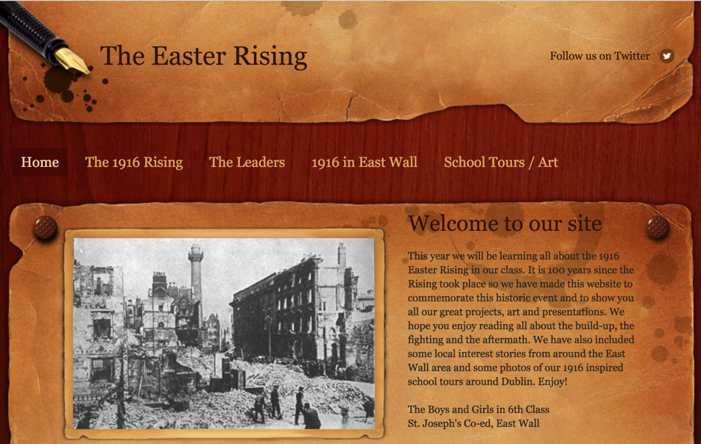
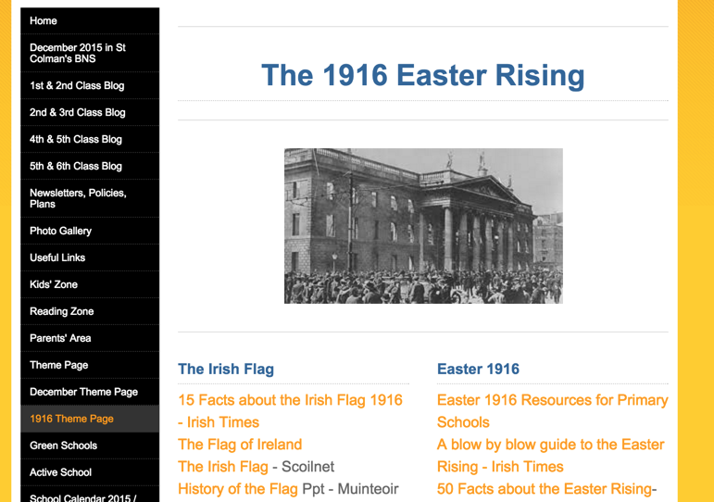
School Websites / Blogs
Some schools have produced some fantastic material and made it available online. Could your school blog or put information on your website about how the Easter Rising affected your community? Explore the content produced by the 2 schools.
St. Joseph’s Co-ed, East Wall
St. Colman’s BNS, Kanturk
Notes:
Show the group the resources that these 2 schools are producing. They are both works in progress.
St. Joseph’s Co-ed, East Wall
http://theeasterrising.weebly.com/
St. Colman’s BNS, Kanturk
http://www.kanturkbns.com/1916-theme-page.html

Slide 23
Teacher Planning
To assist with teacher planning for the 1916 anniversary resources for teacher planning have been made available on www.easter1916.ie/ . Take a few minutes to explore the resources
Notes:
Give the group time to explore the content on this webpage.

Slide 24
Research Projects for Schools
Proclamation for a New Generation
https://www.scoilnet.ie/proclamationtemplate/
1916 Ancestry Project
https://www.scoilnet.ie/1916-ancestry-project/

Slide 25
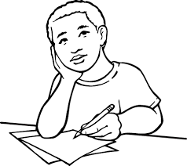
Group Reflection & Discussion
Which tools from this workshop would you now use in your own classroom?
Which of these tools would you recommend to a teaching colleague?
Do you have any other useful resources that could be used?
Do you have any other suggestions as to how ICT could be used to enhance the teaching and learning about the 1916 Rising?
Notes:
Allow teachers time to reflect upon and discuss the points above.

Slide 26
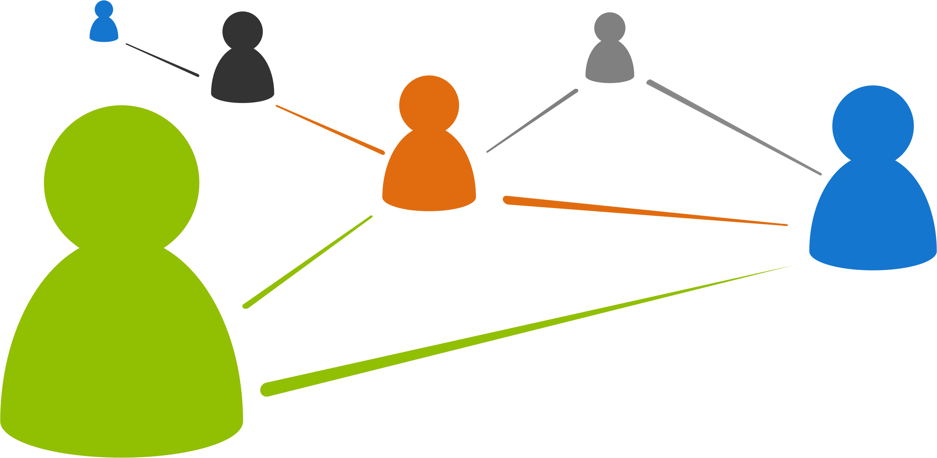
Face to Face Workshops
Based on using ICT for teaching, learning and assessment
Courses available term-time and summer
Aimed at primary and post-primary teachers
Contact your local education centre for dates
Notes:
Information regarding further PDST Technology in Education workshops

Slide 27
Further PDST Workshops
“I still haven’t found what I’m looking for” - Finding and selecting information online
“I don’t know a world without internet; don’t assume I know what I am doing” - Safe and ethical use of the internet
“Let me express myself and my learning digitally” - Creating and making digital resources
“Let me use more than books and pens/pencils” - Reading and writing process using ICT
“A gateway to coding and computational thinking” - Scratch to develop numeracy
“The tablets are working for me!!” - Active learning using tablet devices
“Let us build a film together” - Collaborative film making to develop literacy
“Let me show you what I have created and how I am learning” - Assessment using ICT including the use of ePortfolios
Notes:
Promote future PDST term-time workshops

