Slide 1
Assessment of and for learning through ICT
St Patrick’s College, Thurles
Presenter: David McMahon @davidmcma
On behalf of the @PDST_TechinEd team
Notes:
Please enter details as per session on the slide above.

Slide 2
Learning Outcome: Enable participants to use ICT as an assessment tool to enhance teaching and learning in the primary classroom.
Objectives
Investigate assessment of learning and assessment for learning.
Distinguish between assessment of and for learning.
Familiarise participants with the NCCA Continuum of Assessment (2007).
Identify ICT tools to support assessment and evaluation strategies at primary and post primarylevel.
Use ICT tools to gather, interpret and use assessment information so as to inform teaching and learning.
Notes:
Throughout this workshop we will explain and engage in the language associated with assessment.
Accordingly, we will present the aims/objectives of the workshop in the form of learning outcomes.
In order to achieve this learning outcome, the following success criteria are presented. The success criteria indicate how we will know we have achieved the learning outcome. Thus, in this workshop participants will....
Objectives:
Investigate assessment of learning and assessment for learning.
Distinguish assessment of and for learning
Know the key elements of assessment for learning
Identify ICT tools to support assessment and evaluation strategies at primary level.
Use ICT tools to gather, interpret and use assessment information so as to inform their teaching and their pupils learning.

Slide 3
Synergies for Better Learning
A number of factors are driving the increased use of evaluation and assessment, including:
An increased demand for effectiveness, equity and quality in education to meet economic and social challenges
Improvements in information technology which allow for the development of both large-scale and individualised student assessment and facilitate the sharing and management of data
Greater reliance on evaluation results for evidence-based decision making
OECD, 2013

Slide 4
OECD 2015 Report
As as long as computers and the Internet continue to have a central role in our personal and professional lives, students who have not acquired basic skills in reading, writing and navigating through a digital landscape will find themselves unable to to participate fully in the economic, social and cultural life around them.”
OECD (2015), Students, Computers and Learning: Making the Connection, PISA, OECD Publishing, Paris.(p15)

Slide 5
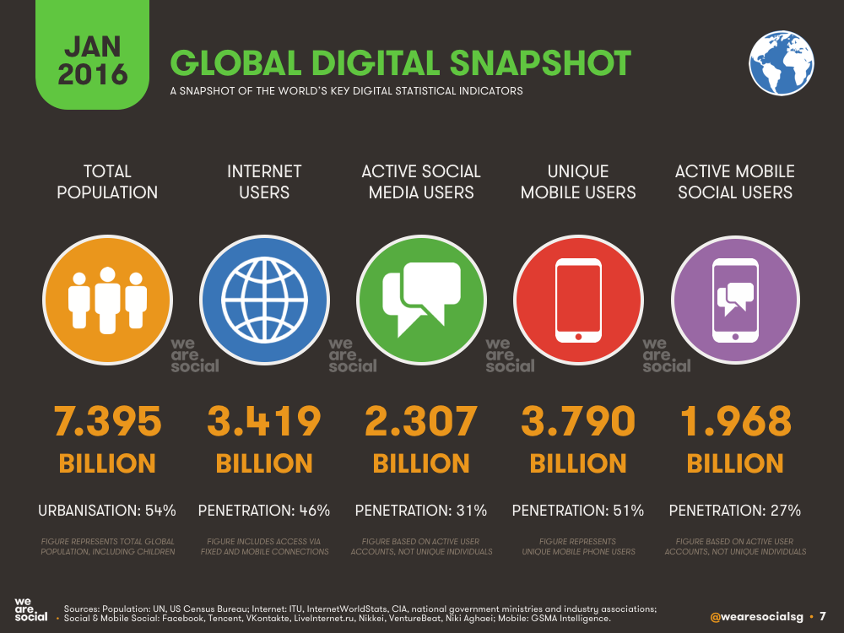
http://wearesocial.com/uk/special-reports/digital-in-2016

Slide 6
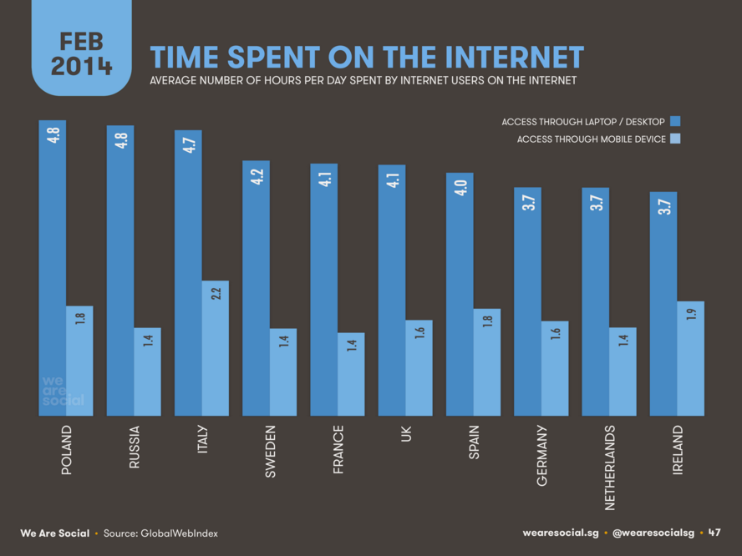
http://wearesocial.com/uk/special-reports/digital-in-2016

Slide 7
Notes:
Using this slide could you define assessment? Can you identify the key elements associated with assessment? This graphic represents a whole host of terminology associated with assessment, ICT and is related to how they can be integrated in everyday teaching and learning. The graphic is created on www.wordle.net/ and also www.tagxedo.com/ if participants want to briefly view it.

Slide 8
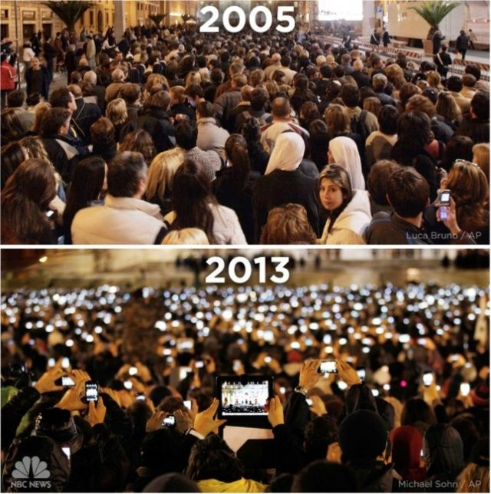

Slide 9
John Dewey
Schools of Tomorrow, 1915
If we teach today’s students as we taught yesterday’s, we rob them of tomorrow.
Notes:
Throughout this workshop we will explain and engage in the language associated with assessment.
Accordingly, we will present the aims/objectives of the workshop in the form of learning outcomes.
In order to achieve this learning outcome, the following success criteria are presented. The success criteria indicate how we will know we have achieved the learning outcome. Thus, in this workshop participants will....
Objectives:
Investigate assessment of learning and assessment for learning.
Distinguish assessment of and for learning
Know the key elements of assessment for learning
Identify ICT tools to support assessment and evaluation strategies at primary level.
Use ICT tools to gather, interpret and use assessment information so as to inform their teaching and their pupils learning.

Slide 10
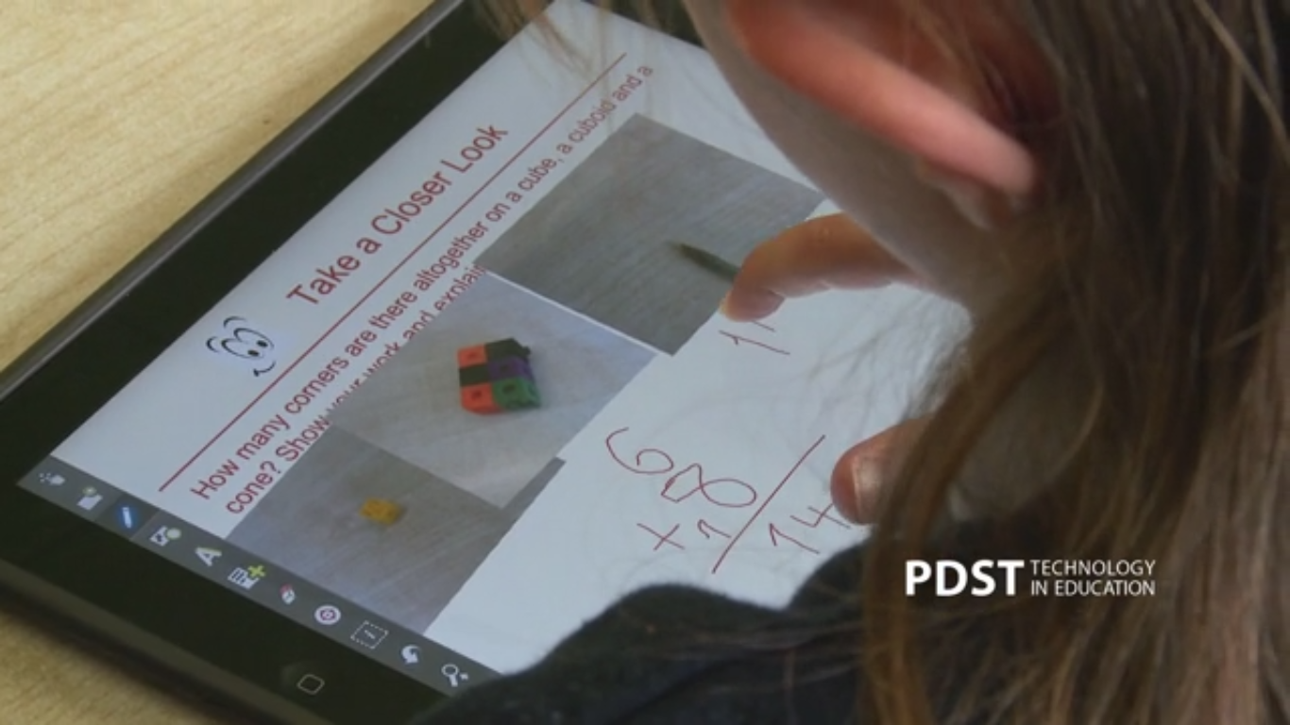
Tablets for AfL & AoL
Notes:
This video is to be accessed from: http://www.pdsttechnologyineducation.ie/en/Good-Practice/Videos/#94673626
More videos of ICT in action in the classroom can be found at: http://www.pdsttechnologyineducation.ie/en/Good-Practice/Videos/#94673626
The purpose of the video is to demonstrate AfL and AoL techniques as used in an Irish primary classroom through tablet technology. This video should provoke discussion as how feedback can be gathered from pupils – and how it can be provided to pupils. Workflow – Explain everything to Google Apps (School are now using Google classroom)

Slide 11
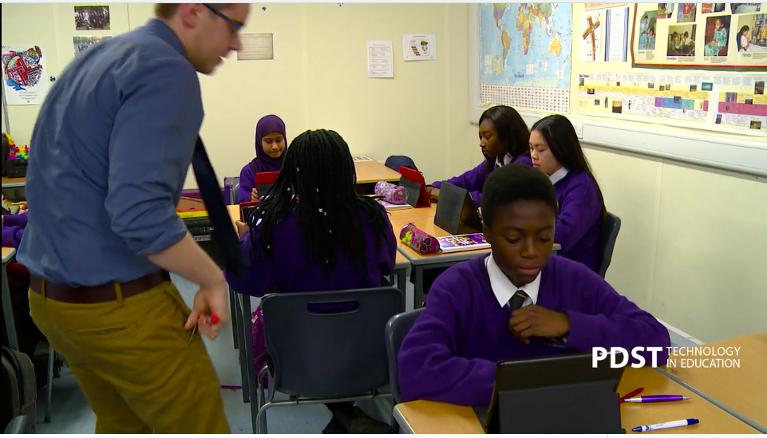
Post Primary Good Practice Videos
http://www.pdsttechnologyineducation.ie/en/Good-Practice/Videos/#153365342
http://www.pdsttechnologyineducation.ie/en/Good-Practice/Videos/#153365342

Slide 12
School Self Evaluation (SSE)
The SSE Guidelines recommend that schools:
Involve pupils in the assessment of their learning
Provide constructive feedback to pupils on their learning.
Use assessment information to evaluate pupils’ understanding, progress and achievement of expected learning outcomes in each curriculum area.
How can you see ICT being of benefit to schools in undertaking the actions above?
School Self-Evaluation Guidelines (2011: 45)
Notes:
SSE highlights that assessment is integral to the teaching and learning process. The assessment data that you gather and reflect on will contribute to the school self evaluation process by providing information for evaluating teaching and learning. (Introduction to SSE Guidelines p7). School self-evaluation is about maintaining high standards and improving the learning experiences and educational outcomes for the students in our schools. It is important that in developing their school self-evaluation processes, schools focus in the first instance on the quality of teaching and learning in classrooms and other learning settings in the school. (SSE Guidelines p7 )
Presenter Notes
Suggestions for teachers when checking student attainment levels
What standards have the students attained?
How do these standards compare with their attainment last
year/when they enrolled in the school?
How does the attainment of our students compare with national
norms (standardised tests, examination results)?
Are there any trends in student attainment?

Slide 13
Defining Assessment
“Assessment in education is about gathering, interpreting and using information about the processes and outcomes of learning. It takes different forms and can be used in a variety of ways...”
Assessment in the Primary School Curriculum Guidelines for Schools
(NCCA 2007: 7)
Assessment Resources NCCA
Notes:
Assessment in education is about gathering, interpreting and using information about the processes and outcomes of learning. In this definition, assessment is about building a picture over time of both a student’s progress and/or achievement in developing knowledge, skills, attitudes and concepts (the outcomes of learning) and also on how the student learns (the learning process). The NCCA also emphasises that many assessment tools are available to teachers and these can be used to test and certify achievement as well as to plan appropriate learning tasks and activities for students in line with their ability and current learning status (a differentiated curriculum) or indeed to provide feedback on student’s strengths and to identify future learning goals.
See link on slide to access online materials on assessment from NCCA*
http://ncca.ie/en/Curriculum_and_Assessment/Early_Childhood_and_Primary_Education/Primary-Education/Assessment/Assessment_Guidelines/

Slide 14
Continuum of Assessment
NCCA Assessment Continuum
(NCCA :2007)
Notes:
The NCCA state that assessment takes many different forms and can be used in a variety of ways. This is reflected in their continuum of assessment which suggests a range of assessment approaches that teachers may wish to use in their classrooms. (Assessment in the Primary School Curriculum, Guidelines for Schools, NCCA, 2007).
The methods range from observation and questioning as part of daily teaching and learning, to more formal and structured teacher designed tests, standardised tests, portfolios and student self assessment.
These provide a menu of complementary approaches from which teachers can select and use to build up a profile of a student’s learning on a short term (day-to-day) and longer-term basis. It is also evident from this continuum that assessment approaches positioned towards the left of the continuum are those in which the student has a key role in assessing his/her own work while towards the right of the continuum the teacher plays a greater role in leading the assessment. It may also be suggested that the methods towards the right of the continuum are summative or assessment of learning approaches while those to the left of the continuum could be considered as formative or assessment for learning. Self assessment and peer assessment may also be regarded as assessment as learning.
See link on slide to access online materials on assessment from NCCA*
http://www.ncca.biz/guidelines/intro.htm

Slide 15
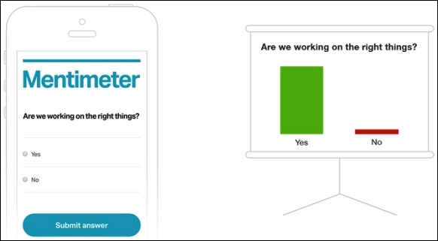
How do you currently use ICT in your own classroom?
Notes:
This is a sample Padlet http://padlet.com/davidmcmahon/ict. The tutor will need to make a similar wall to this and share the wall with participants. Introduce Padlet by means of asking the question above ‘how do you currently use ICT in teaching’? Take participant feedback by means of a Padlet wall, each participant adds their own sticky note to the wall to get an overview of current practice from the group remember to share your Padlet wall url with your audience and demonstrate how to add a post and download your wall – show the sample wall linked underneath before moving on.
Sample Wall: http://padlet.com/davidmcmahon/ict

Slide 16
Introduction to Socrative
Socrative is device neutral and allows teachers to engage and assess their students with assessment activities on tablets, laptops and smartphones.
Students can also gain immediate feedback to enhance assessment as learning within the classroom.
Socrative saves time so the class can further collaborate, discuss, and extend their understanding of a topic using various assessment strategies.
Notes:
Tutor Notes:
To demonstrate the various features of Socrative (real time questioning, result aggregation, etc.) that can be used for Assessment of and as learning, tutor to ask participants to take a student paced – immediate feedback quiz Socrative Quiz
In order to run this quiz tutors will need to create their own account and import the quiz that has already been created. To do this from the Dashboard click on ‘Manage Quizzes’ and then ‘Import Quiz’.
Enter the SOC Number: SOC-13139152 Return to your Dashboard and select ‘Start a Quiz’ You should now see a quiz entitled ‘Copy of Tutor Training (Assessment Workshop 1 – Sample Quiz). To run this quiz on the day of the workshop click on the quiz and select ‘Student Paced – Immediate Feedback’ and ‘Start’. Prompt participants to login as a student to Socrative and enter the Room Number that appears at the top of the screen.
As a natural progression to highlighting the possible assessment types, tutor to demonstrate:
The various assessment features within Socrative (Student Paced – Immediate feedback, Student Navigation, and Teacher paced).The various quiz types (simple quiz, space race, exit ticket).
Leading on from this, tutor to guide participants through the creation of a simple quiz using the various question types (multiple choice, True False, Short Answer).
Sample Room Dublin: 182187

Slide 17
Socrative
Student Task
Socrative Teacher on App Store
Notes:
Tutor Notes: Tutor to lead the activity above by guiding participants through the process of creating and generating a Socrative quiz online. Direct participants through the process of sharing their quiz, asking other to log in and analyse the feedback.
Ask participants to create a Socrative quiz on a topic they have covered recently consisting of 5 short answer/multiple choice questions.
Finally, when participants have completed the Socrative task, draw attention to the Socrative Garden website (http://www.socrative.com/garden/) that contains in excess of 1500 quizzes covering various topics that can be imported and modified according to user requirements.
Search for Socrative Quizzes https://docs.google.com/a/pdst.ie/spreadsheets/d/1dtoP6ivVNJtqTw0d6OSKLEq5WlZZ7ak9onjU1kph0Co/edit#gid=20451944

Slide 18
Assessing Progress During Lessons
Using ICT applications and resources to:
Measure student progress
Generate class discussion
Encourage open-ended questions
Foster higher order questions
Notes:
This slide introduces the next section of the workshop that give examples of how teachers can use questioning to elicit class discussion and to formatively assess, orally, how students are progressing in the learning during class. It can also be used to reflect on the key elements of assessment which have been covered through Edmodo to date in this session.
The graphic illustrates numerous ways in which modern devices such as laptop, tablets, mobiles, etc can be used as a response system to assess progress during lessons
Reminder: Open questions can have a variety of answers and tend to demand higher level thinking skills; closed questions have one, or a few answers i.e. factual recall. Lower order questions can be termed as factual and “easy” questions as in higher order questions to encourage sophisticated thinking.

Slide 19
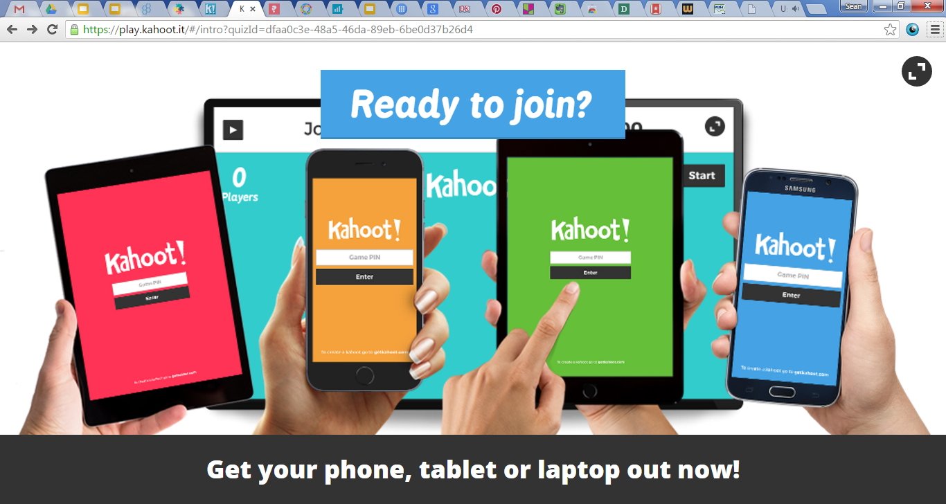
Kahoot for Assessment Audience Task
https://play.kahoot.it/#/lobby?quizId=a718db93-a267-4bfe-b488-1119b9fd59d0

Slide 20
Kahoot for Assessment Features & Functions
Create quizzes, discussion forums and surveys
Device neutral and easy to use
Can be used for AfL or AoL
Can be used for collaborative learning, feedback or group discussion
Notes:
Go through the process of creating a quiz in Kahoot – including adding in pictures or videos.
Show how the time limit can be changed on a question to allow for group collaboration
Show how to start the quiz in a group setting and get participants to join by giving the game pin
Show how to search for public quizzes
Briefly demonstrate the discussion forum and quiz facility
The next stage is guiding participants through the initial steps in creating an account i.e. select quiz, name quiz, add question, add answers before deciding on audience, private versus public setting and finally description (10 – 15 mins)
Ask Participants to create a Maths themed quiz (e.g. 3-D shapes, angles, number facts, etc.) with 5 questions, including some pictures
If time permits run one of the quizzes for the group.
NB Tutors need to create their own Kahoot Account before running this session*

Slide 21
EDpuzzle Assessment through Interactive Video
Website: https://edpuzzle.com/ EDpuzzle on App Store
Sample Lesson https://edpuzzle.com/assignments/54779baf7a9da1021597f521/watch
Notes:
Sample Lesson 1: World’s Biggest Bats: https://edpuzzle.com/media/546dd6bff2b4006251db97f4
Sample Lesson 2: River Dolphins: https://edpuzzle.com/media/543d2ba45fc9b6056d6ed338
This is the introduction Ed Puzzle. Tutors to access their own pre-created account after training to demonstrate the follow features for participant. The first tutorial video participants see when signed in is https://edpuzzle.com/media/edit
My Content: This tab allows you to search the library of pre-created teaching videos in Ed Puzzle e.g. perform a search for Fractions.
My Content: To create a lesson using a video, perform a search using the National Geographic channel for ‘Pink Dolphins’ – use this video of 2:28 length to create a lesson to be used in writing through the report genre in literacy for fifth and sixth class. We import the video, add four to five sample questions, crop the video, add an audio comment and then share our video.
My Classes: Add to your teacher generated video library, add and save a class and assign work through folders etc.
Home: Check what you students have learned.
Allow all participants at least ten to fifteen minutes to complete these tasks and experiment online with their own
EDpuzzle videos for their classrooms. Other relevant sites that support EDpuzzle include
http://www.neok12.com/World-War-II.htm as well as http://www.videonot.es/ and https://www.educanon.com/

Slide 22
EDpuzzle Key Features for Teachers
Create and share interactive video lessons.
Highly engaging and device neutral.
Can be used in 1:1, small group or whole class settings. Encourages group discussion through higher order questioning.
Share and embed EDpuzzle videos in your Edmodo page.
Free iOS app for tablets and smartphones
Can be easily integrated with literacy, SSE and numeracy topics as per teacher’s individual classroom planning.
Notes:
EDpuzzle has many impressive features that make it a very effective way of integrating video in instruction. It can be used in primary or post primary classrooms or even assigned to students to work on at home. It encourages attention, questioning, active learning and incorporates the needs of visual / aural learners in a unique way. It is also device neutral i.e. works on tablets, smartphones and PC and can be transferred to other assessment tools such as Edmodo and Google Classroom, including some ICT & Assessment that you’ve already seen in this course to date.

Slide 23
EDpuzzle in the Classroom Suggestions & Ideas
Geography
Natural Environment
Science
Human, plant and animal life.
History
Life, culture and society in the past.
EDpuzzle
Notes:
EDpuzzle can be used as a cross curricular resource in order to actively engage pupils in their daily learning activities. Using video as part of instruction can allow the teacher to see opportunities for assessment in action e.g. setting questions at key intervals, asking higher order questions, giving effective feedback, providing opportunities for pupils to learn collaboratively and then allowing students to create their own EDpuzzle projects i.e. flipping the learning in the classroom. Finish with group discussion with feedback from participants on how they would use this in their own classroom.

Slide 24
Blend Space Interactive Lessons
www.blendspace.com
BlendSpace Student iPad App
Notes:
www.blendspace.com
Introduce Blendspace by showing group the sample lesson on Volcanoes which can be found at: http://blnds.co/1nxxF38
Show from a student’s perspective how they can comment on the content.
Go through the following features of a lesson: Adding a video, adding an image, adding a webpage, adding a Google Document/Dropbox document or uploading a document, creating a quiz, give an overview of lesson types not shown (OpenEd, Educreations, Gooru)
Show participants how to create a class and monitor their progress
Demonstrate how to search for other lessons in the Gallery
Task: Ask participants to create a Blendspace lesson with 6 elements on an SSE topic they have covered recently.
NB Tutors will need to have their own account created in advance
Blendspace iPad App: https://itunes.apple.com/ie/app/blendspace-for-schools-student/id824378660?mt=8

Slide 25
BlendSpace Features & Functions
Find and share resources in one place
Students can comment and take notes on content
Quizzes provide for AoL & AfL
Can analyse and interpret results
Lessons can be added to Edmodo
In built assessment in every lesson
https://www.tes.com/lessons/Ox-ZxHsuZSg0EA/world-war-ii
Notes:
In https://www.blendspace.com/ participants can find and share resources in one place
Students can comment and take notes on content
Quizzes provided for AoL & AfL
Ability to analyse and interpret results
Lessons can be added to Edmodo
In-built assessment in every lesson

Slide 26
Blend Space Classroom Application
How do you see yourself using Blend Space in the classroom?
How could Blend Space be used for Assessment of Learning (AoL)?
How could Blend Space be used for Assessment for Learning (AfL)?
Notes:
Tutor to ask particpants to reflect on how Blendspace could be used in the classroom for both Assessment of Learning and Assessment for Learning. Refer back to the NCCA Assessment continuum. The following examples could be used to lead discussion:
AoL – Teacher designed tasks and tests
AfL – Conferencing on web content

Slide 27
Which tool from today’s workshop are you most likely to use in your classroom?
Notes:
This is a sample Padlet http://padlet.com/davidmcmahon/ict. The tutor will need to make a similar wall to this and share the wall with participants. Introduce Padlet by means of asking the question above ‘how do you currently use ICT in teaching’? Take participant feedback by means of a Padlet wall, each participant adds their own sticky note to the wall to get an overview of current practice from the group remember to share your Padlet wall url with your audience and demonstrate how to add a post and download your wall – show the sample wall linked underneath before moving on.
Sample Wall: http://padlet.com/davidmcmahon/ict

