Slide 1
Developing Digital and ICT Literacies
Finding, evaluating and curating information online
Term Time Workshop 2015 / 2016
Session One
Venue:
Presenter:
© PDST Technology in Education 2015
This work is made available under the terms of the Creative Commons Attribution Share Alike 3.0 Licence http://creativecommons.org/licenses/by-sa/3.0/ie/. You may use and re-use this material (not including images and logos) free of charge in any format or medium, under the terms of the Creative Commons Attribution Share Alike Licence.
Notes:
Please enter details as per session on the slide above.

Slide 2
Developing Digital and ICT Literacies
Finding, evaluating and curating information
Purpose
To introduce teachers to the many ways we can search for information online
To discuss how the skills of skimming, scanning, determining importance and summarising can be developed in an online environment
Understand the ethical and legal issues concerning information sourced online.
To explore methods and resources for assessing, evaluating and curating information online.
Notes:
Please share and discuss the key messages above with all participants.

Slide 3
Developing Digital and ICT Literacies
Finding, evaluating and curating information
Session One Objectives:
To show teachers that the skills of skimming, scanning, determining importance and summarising can often be lost by the convenience of search engines
To discover a range of search engines designed for student use
To demonstrate how relevant digital literacy skills in finding and selecting information can be developed
Notes:
Overview of course objectives to be provided to all participants.

Slide 4
21st Century Skills Tools for Working
Digital Literacy | To access and evaluate using ICT To use and manage information online To create media products To apply technology effectively
Information Literacy | To access and evaluate information To use and manage information To be able to search, collect, organise and process information To be able to use technology as a tool to research, organise and collect information
Adapted from: Binkley, M., Erstad, O., Hermna, J., Raizen, S., Ripley, M., Miller-Ricci, M., & Rumble, M. (2012).
Defining Twenty-First Century Skills.In Griffin, P., Care, E., & McGaw, B. Assessment and Teaching of 21st Century Skills, Dordrecht, Springer.
Notes:
While many of the so-called 21st century skills have been in use for millennia, e.g. communication, critical thinking, collaboration, creativity, some skills justly deserve the term. In particular, under the heading of “Tools for working” from Hamma et al, “Defining 21st century skills”, digital literacy and information literacy are key skills that students need in order to navigate through the overload of information currently available online and synthesise the information they find during their research. In this workshop, we will explore how students can use technology effectively to search, collect and organise information as well as outline how students can conduct research online and cite their sources, a skill that will be required by them when they progress to third level education.

Slide 5
Determine the extent of information needed
Experience information literacy as part of lifelong learning
Access information efficiently
Information literate people...
Access and use information legally and ethically
Critically evaluate information and its sources
Classify, store, manipulate and redraft information needed
Adapted from: Binkley, M., Erstad, O., Hermna, J., Raizen, S., Ripley, M., Miller-Ricci, M., & Rumble, M. (2012).
Defining Twenty-First Century Skills.In Griffin, P., Care, E., & McGaw, B. Assessment and Teaching of 21st Century Skills, Dordrecht, Springer.
Notes:
Note to tutors:
Initially just reveal the centre circle and ask participants what skills they think information literate people require. When feedback from participants has been gathered, reveal each skill in turn. In this workshop and the next, the skills which will be developed in particular will be:
accessing information efficiently - through search operators
critically evaluating information and its sources - through interrogation of websites
classifying, storing, manipulating and redrafting information needed - through curation tools like Diigo, Pinterest, Blendspace, etc.
accessing and using information legally and ethically - through copyright, creative commons, Google image search

Slide 6
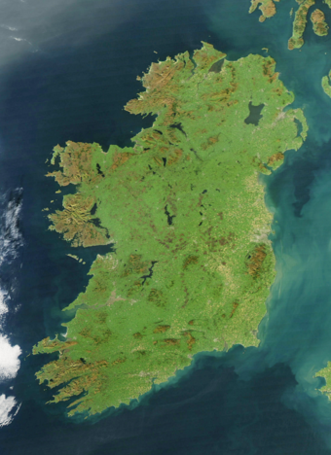
Open Computer Quiz
What is the oldest town in Ireland?
Name the smallest fishing harbour in Europe.
Name the only golf course in Ireland which was designed by a woman?
Where was the founder of the Home Rule movement born (village/county)?
What is the link between answers 1 - 4.
https://commons.wikimedia.org/wiki/File:Ireland_(MODIS).jpg#/media/File:Ireland_(MODIS).jpg
Notes:
Tutor Notes:
Ballyshannon
Bunbeg
St. Patrick’s Golf Links: Tra Mor (Carrigart)
Glenfin/Donegal
All are located in Donegal
Tutors can personalise their own quiz if they wish

Slide 7
“As these results show, the connections among students, computers and learning are neither simple nor hard-wired; and the real contributions ICT can make to teaching and learning have yet to be fully realised and exploited. But as long as computers and the Internet continue to have a central role in our personal and professional lives, students who have not acquired basic skills in reading, writing and navigating through a digital landscape will find themselves unable to to participate fully in the economic, social and cultural life around them.”
OECD (2015), Students, Computers and Learning: Making the Connection, PISA, OECD Publishing, Paris.(p15)
Notes:
The recent publication of the OECD report: Students, Computers and Learning: Making the Connection spawned a lot of sensationalist headlines which seemed to imply that there was an inverse correlation between the use of technology in school and learner outcomes.
However, those who read the report in full will realise that the true potential of technology in learning has yet to be fully realised: “technology can support new pedagogies that focus on learners as active participants with tools for inquiry-based pedagogies and collaborative workspaces” (p4).
Information and communication technologies can support and enhance learning. With access to computers and the Internet, students can search for information and acquire new knowledge beyond what is available through teachers and textbooks (p.50)
Several features of ICT support teachers in giving adaptive feedback to students and, more generally, individualising instruction; in other words, they support student-oriented and formative assessment behaviours in teachers’ classroom practice. They also facilitate collaborative projects and enable teachers to extend the spatial and temporal boundaries of their lessons, thus creating the potential for cognitively challenging and engaging activities (p.74)
The full report can be accessed at http://www.keepeek.com/Digital-Asset-Management/oecd/education/students-computers-and-learning_9789264239555-en#page1

Slide 8
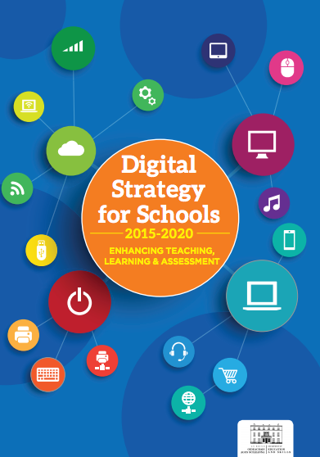
Digital Strategy (2015 - 2020)
Multi-annual investment
Integration of digital skills into the curriculum and in assessment
Professional development for teachers
Embed ICT skills as part of initial teacher training
Provide enhanced digital content for schools
Promote safe and responsible use of internet and social media
Notes:
The strategy is available for download at http://www.education.ie/en/Publications/Policy-Reports/Digital-Strategy-for-Schools-2015-2020.pdf.
For more information, please see http://www.pdsttechnologyineducation.ie/en/NEWS/Digital-Strategy-for-Schools-2015-2020-Enhancing-Teaching-Learning-Assessment-launched.html

Slide 9
“The meaning of ‘knowing’ has shifted from being able to remember and repeat information to being able to find and use it.”
Dr. Herbert Simon
Notes:
Dr. Simon is widely regarded as the founder of the field of artificial intelligence.

Slide 10
Getting information off the internet is like taking a drink from a fire hydrant.
Mitchell Kapor
Notes:
Emphasise the fact that there is so much information available online that it can be difficult to isolate the quality from the noise, while inexperienced researchers frequently get caught in a rabbit hole online, spending hours searching for relevant information.
Mitchell Kapor is the founding chair of Mozilla Firefox.

Slide 11
Information Age Scarcity to Abundance
Notes:
For definitions, we traditionally consulted a dictionary; more detailed information for projects required access to an encyclopedia and primary sources were journals, newspapers and magazines.
In a few short years, we have moved from scarcity of sources of information to an abundance of information through a variety of devices.

Slide 12
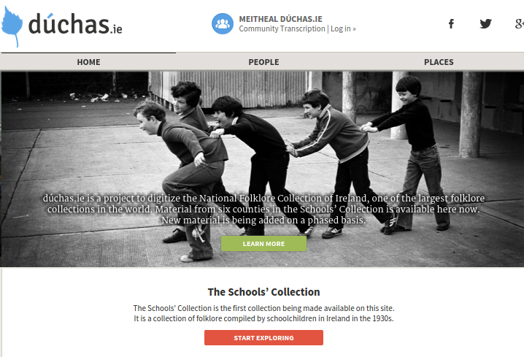
www.duchas.ie
The Schools’ Collection
Notes:
The objective of the project is to initiate the digitization¹ of the National Folklore Collection (NFC) so that, by 2016:
(i) the public will have access to material from the Collection (a significant portion of the Schools’ Collection) on the public website (www.duchas.ie) and
(ii) a data management system will be available for NFC to which other material can be added in future.

Slide 13
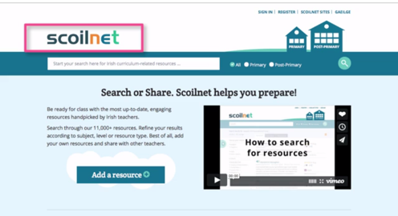
Scoilnet Overview
http://www.pdsttechnologyineducation.ie/en/Good-Practice/Videos/#96126728
Notes:
Show the Scoilnet Overview video from the PDST Technology in Education Good Practice page: http://www.pdsttechnologyineducation.ie/en/Good-Practice/Videos/#96126728
Demonstrate the search facility and the filtering options that appear after a search on the left hand pane.
Give the group time to perform a search and filter for a relevant resource.
TUTOR NOTES: Find a subject specific topic to search for in Scoilnet. Possible alternative topics: earthquakes, marketing, poetry, World War I.

Slide 14
Use Scoilnet to:
Find 11,000 + resources reviewed and mapped to the curriculum by teachers
Upload and share resources you have created or found, supporting peers in curriculum delivery
Create Learning Paths as a means of grouping and forming collections of resources
Include the Scoilnet API on your site to enable a Scoilnet search from within your site
Access Britannica for trustworthy and quality multimedia content.
Notes:
Explore some of the key features of Scoilnet

Slide 15
“We no longer need an education system that helps students simply remember facts and figures. We need them to be critical consumers of information….
As consumers of information via technology we need to be able to find out how to do things without direct instruction; to find an answer to a question using a tablet computer or other mobile device.”
Patrick Griffin (2012)
Chair of Education (assessment) Melbourne Graduate School of Education at University of Melbourne
Notes:
While anyone can find information online, it is becoming increasingly clear that we need the skills to critically examine the information and determine whether or not it is relevant to answer the questions we have. The skills of skimming, scanning, determining importance and summarising have been lost by the convenience of search engines.

Slide 16
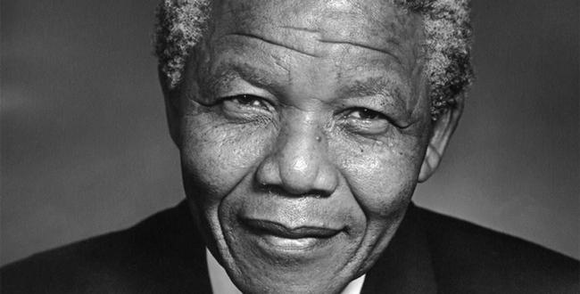
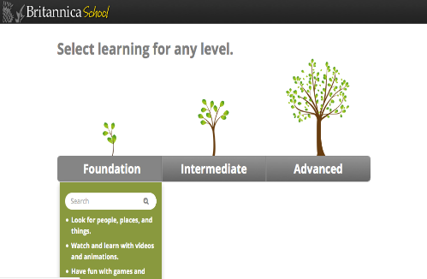
Encyclopedia Britannica
The three levels of learning in Britannica School
Foundation
Intermediate
Advanced
Group Task: Using Britannica School Foundation Level perform a search for Nelson Mandela. Can you read this article at three different levels of difficulty?
Notes:
Navigate to www.scoilnet.ie
All schools, students, teachers and parents have free access to Britannica School, which has been paid for by Scoilnet. This breaks down the digital divide, as all our students have access to the internet via a number of devices, e.g. smartphone, tablet, laptop, PC, games console.
Click on the link to access Britannica
Demonstrate:
Three levels
Foundation level – 6 ways to navigate – teacher and student levels
Intermediate level – Upper Primary/lower post primary
Articles, media, biographies, further interactive resources
Advanced – Post Primary
Tutor demonstrates features below
Log in
Articles
Media - Show the images and the video of the polar bear
Animal Kingdom
World Atlas
Compare counties
Learning Games
My content
Increase font
Read text aloud
Favourite
Print and email functions
Reading level
Teacher options - curriculum
Task: Using Britannica School Foundation Level perform a search for Charles Stewart Parnell, James Connolly, Pablo Picasso, Cubism, Louisa May Alcott, Nelson Mandela, 3D Printing, European Union. Can you read this biography at three different levels of difficulty?

Slide 17
Britannica School
Key Classroom Features
Read Aloud
Decrease / Increase Font
‘Select’ ‘Define’ Feature
Adjust Reading Level
Related Reading
Teacher Page - Irish Curriculum Link
http://school.eb.co.uk/levels
Notes:
Give adequate time to participants to investigate the key features listed in the slide above. Each of these features can be used to accommodate a range of learning styles and needs.
Sample article on J.K. Rowling http://school.eb.co.uk/levels/foundation/article/441579 or Neil Armstrong http://school.eb.co.uk/levels/foundation/article/439700 can be used to showcase these features to your audience.
Demonstrate how articles within Britannica are linked to the strands and strand units through the teacher page
Adjusting the reading level can be particularly useful for differentiating for different students.

Slide 18
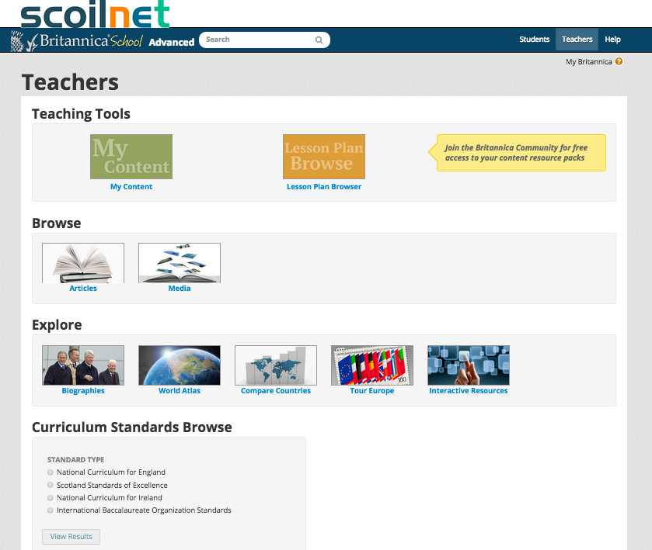
Britannica School
Classroom Application
Suggested Usage
Individual Work
Co-operative Learning
Whole Class
SEN Classroom
Linked on your school website to transfer learning to the home environment
See http://school.eb.co.uk/levels/advanced/educators
Notes:
Britannica can be used in a range of different ways, as described in the slide above. Discuss with participants. Ask for feedback in any other format in which it can be used in the classroom or at home.
A range of teacher resources are available at http://school.eb.co.uk/levels/advanced/educators and http://school.eb.co.uk/levels/intermediate/educators mapped to the Irish curriculum for a range of subjects.

Slide 19
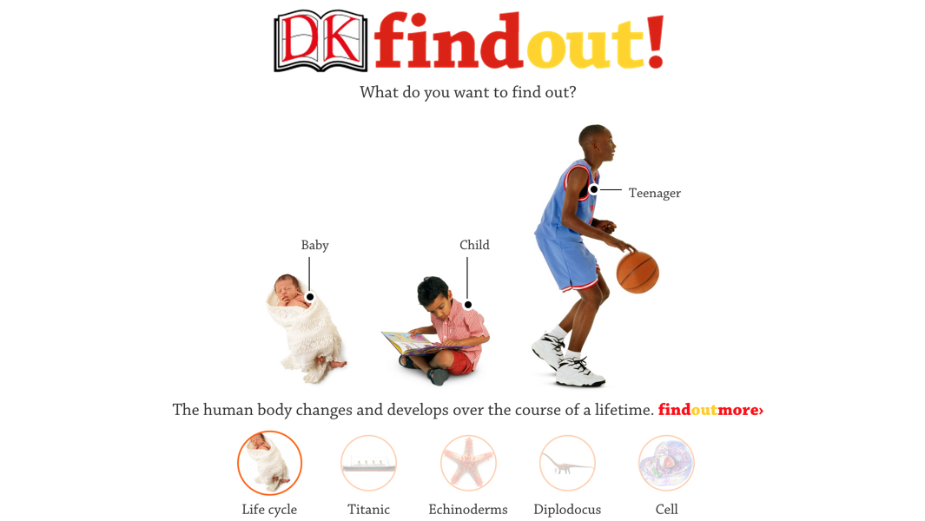
DK Find Out!
Task: Use the search facility to find the article about light. Explore all of the features available within the article.
Notes:
Tutor to demonstrate the DK Find Out! website as a further primary source of information.
Demonstrate the main features of the site:
Articles - selecting links within an article
Quiz
Videos
Explore
Fun Facts
Galleries
Task: Use the search facility to find the article about light (or a subject-related topic of your choice). Explore all of the features available within the article.
Possible searches: your amazing body, geometry, celts, chemicals, earthquakes, vikings, world war two

Slide 20
ICT Component of Key Skills
Managing myself
Communicating
Being creative
Managing information and thinking
Working with others
Staying well
Notes:
While each of the Key Skills of the new Junior Cycle has an ICT/digital component, in this course we will concentrate on just three:
Staying well
Managing information and thinking
Managing myself (to be explored in session two)
Other PDST Technology in Education courses have been designed to meet the ICT components of other key skills, e.g. creating and using digital resources (creativity).
The ICT components of being creative, communicating and working with others have been outlined below
ICT components of key skills:
Being creative
Element: Stimulating creativity using digital technology
Learning Outcomes
Students can….
Be innovative and creative in using digital technology to learn, think and express themselves
Explore the possibilities of mixing different technologies and digital media to help them reflect, problem solve and present ideas
Create digital media objects which demonstrate creativity and imagination to present learning
Working with others
Element
Working with others through digital technology
Learning Outcomes
Students can….
Demonstrate collaborative learning using digital technology
Use digital technology to participate in collaborative learning and communication spaces
Respect the rights and feelings of others when using digital media
Adapted from Key Skills of Junior Cycle, NCCA
Communicating
Element: Using digital technology to communicate
Learning Outcomes
Students can….
Use digital technology creatively to present, interact with and share ideas for different audiences
Make decisions about how best to communicate for particular purposes
Be respectful and responsible in my digital and online communications

Slide 21
Managing Information and Thinking
Element
Using ICT and digital media to access, manage and share content
Learning Outcomes
Students can….
Source, share and evaluate information they find in different technologies and digital media formats
Use digital tools to expand their thinking and source information
Understand how to use content and present it differently while respecting copyright
Use different technologies and digital media tools to give and receive feedback
Adapted from Key Skills of Junior Cycle, NCCA
Notes:
The safe searching section of this workshop has explored various tools for sourcing information. Initially we concentrated on using alternatives to Google, and towards the end of this session, participants will explore how they and their students can become more efficient searchers on Google and other search engines.

Slide 22
Staying well
Element
Being responsible, safe and ethical in using digital technology
Learning Outcomes
Students can….
Identify situations where their personal safety and wellbeing, and that of others, is put at risk by digital technology and know how to cope
Respect the rights and responsibilities of others in using digital technology
Protect their personal privacy online
Adapted from Key Skills of Junior Cycle, NCCA
Notes:
Students are unaware that they frequently break copyright laws (as indeed are many teachers). Images and other copyrighted works must be ethically obtained and sources should always be cited in projects. When technology is used to merely copy and paste information, very little learning is actually being achieved.
While very important for all students and teachers, personal safety online is beyond the scope of this course. There are however excellent resources for teachers, parents and students available at http://www.webwise.ie/ which participants may wish to familiarise themselves with. In addition, another workshop will be available shortly in education centres , “I don’t know a world without internet; don’t assume I know what I am doing” - safe and ethical use of the internet

Slide 23
Copyright
Covers images, audio and completed work of pupils
Copyright and publishing policies should be covered in your school’s Acceptable Use Policy
ClipArt and Images found online will be copyright protected
Creative Commons Licensing allows users to specify how material can be used. It does not mean giving up copyright, instead it means offering some of your rights to any member of the public under certain conditions.
Notes:
Cover key features as outlined above in the use of images and the need to respect copyright. Schools in Ireland have been served with cease and desist letters from Getty Images for use of images on their website where they did not seek permission to use.
Additional information on the various types of creative commons licensing is available at: https://creativecommons.org/licenses/
Please note the licensing for the course materials for this workshop!

Slide 24
Google Image Search
Google Image Search offers a great range of images
Can you reuse all of them in a document or presentation?
There are copyright issues
Possibility of contacting the owner of the image
Notes:
Google Image search is a great way of accessing images online but there are copyright issues if you are to reuse the image in a document or presentation. Some images will carry a copyright, some are free for use and others are undefined. If you use an image which is copyrighted or is undefined you could be infringing on copyright. If you find an image you really like there is the possibility of contacting the owner to seek permission to reuse the image.
Task: Perform a search for your local area in Google Images. It is possible that if you take the images and reuse them for your own purposes that you could be infringing on someone’s copyright. Now change the search by selecting Search Tools -> Usage Rights -> Labeled for reuse with modification. You will probably see a smaller collection of images but all of the images can be used safely without infringing on any person’s copyright.
Task: Compare a traditional image search with a search where the usage rights have been changed.

Slide 25
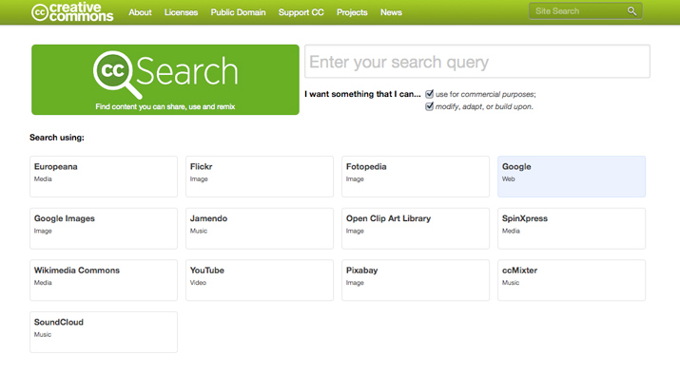
Creative Commons Image Search
Use Creative Commons Image search to look for copyright free images from a range of sources
Notes:
The Creative Commons search facility allows you to search a range of sites including Wikipedia, Flickr and Google Images for pictures that can be copied and edited freely without any copyright infringement.
Another alternative is http://www.photosforclass.com/ which automatically cites the source of the image.
Task: Search for an image about the weather that has been labelled “modify, adapt or build upon”

Slide 26
https://youtu.be/PcZg51Il9no?t=36s
Notes:
Although a couple of years old, there is still relevant information contained in this video. Click on the link below which begins the video at 36 seconds. Recommend playing from 36 seconds until 1.46 or 2.24. While the rest of the video makes for interesting viewing, it may be beyond the time constraints of this workshop to play it all. Participants can view it at a later stage.
One notable statistic at 2.51 states that “It is estimated that a week’s worth of the New York Times contains more information than a person was likely to come across in a lifetime in the 18th century”, while at 2.57 it states that “90% of the world’s data has been generated in the last two years”.
It is therefore crucial that students learn the skills to navigate through the abundance of information available online and access appropriate content.

Slide 27
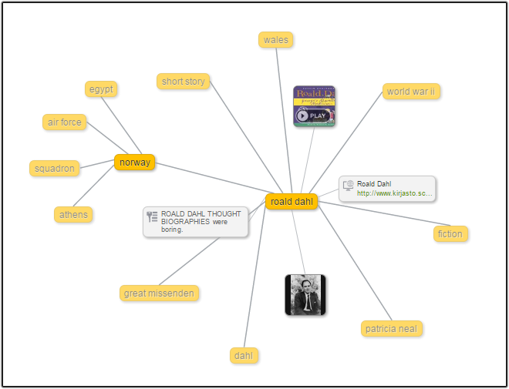
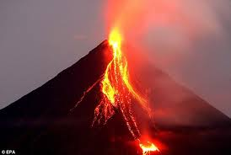
Instagrok
A Visual Search Engine
Group Task: Perform a search for the topic of ‘volcanoes’ on http://www.instagrok.com/. How would you use this resource in your own teaching?
Notes:
A search facility with an interesting visual element is at http://www.instagrok.com/ where the search is presented as a mind map with a number of links – core information, images and videos. Once logged in, the pupil can make notes and keep a journal of the their entire project. The subscription based classroom version allows the teacher to view all the research being undertaken by the pupils aligned to this subscription.
It is often the case that children can be easily overwhelmed with information and are unable to identify what is credible and relevant. Instagrok allows students to perform a search and returns a visual representation with expandable information.
Tutor to demonstrate the following:
•Registering for an account – Gmail or other
•How to perform a Grok search
•Using the visual graph
•Expanding a branch
•On a node examine:
•Key Facts
•Websites
•Videos
•Images
•Concepts
•Notes
•The Journal Tab
•The Quiz Tab
Task: Give participants time to explore and perform a Grok on Roald Dahl. Ask them to examine the visual results, use the journal facility to make notes on a particular node and take the quiz. Compare the information on Instagrok to that on the Roald Dahl website

Slide 28
World Wonders Project
Notes:
Tutor to play the video to give an overview of Google’s World Wonders Project.
World Wonders brings modern and ancient world heritage sites online using Street View, 3D modelling and other Google technologies. Explore historic sites including Stonehenge, the archaeological areas of Pompeii and the Great Barrier Reef as if you were there. Learn about the history and background of each location with information provided through a partnership with UNESCO.

Slide 29
Google Cultural Institute
Key Features
World Wonders
Historic Moments
Art Project
Experiential Learning
Primary Sources
Task 1: Explore Scott’s Hut and suggest a way this could be used as part of a literacy lesson
Task 2: Walk through the Van Gogh Museum and find ‘The Bedroom’ and ‘Sunflowers’ paintings. Could this be used for any of the writing genres?
Notes:
Through Google Cultural Institute participants can investigate cultural features from around the world
https://www.google.com/culturalinstitute/home
Tutor must demonstrate the following features:
Search function, street view, map view, location view, navigation and locate on world map
Possible searches:
Scott’s Hut (World Wonders)
Pyramids at Giza (World Wonders)
Great Barrier Reef (World Wonders)
1916 (Historic Moments)
Nelson Mandela (Historic Moments)
Anne Frank Exhibition (Art Project)
Van Gogh Museum (Art Project)
Musée D’Orsay (Art Project)
Tasks: The tasks should be used to generate a discussion on how Google Cultural Institute could be used as part of an integrated literacy lesson.
Perhaps Scott’s Hut could be used to write a first person account of Tom Crean’s time in Antarctica. Could the Van Gogh Museum be used for a piece of procedural writing to give directions?
World Wonders brings modern and ancient world heritage sites online using Street View, 3D modelling and other Google technologies. Explore historic sites including Stonehenge, the archaeological areas of Pompeii and the Great Barrier Reef as if you were there. Learn about the history and background of each location with information provided through a partnership with UNESCO.

Slide 30
Classroom Practice
The Secondary Guide
Suggested use
Curriculum links
Appropriate questions
Lesson plans
Planning aid
Notes:
Make participants aware that there is a Post-Primary Guide for using Google Cultural Institute in the classroom. It can be accessed from the following page: http://www.google.com/culturalinstitute/about/wonders/education/

Slide 31
Google Treks
Task: Visit the Khumbu region in Nepal. Follow the journey of the Sherpa people deep in the sacred valleys in the shadow of Mt. Everest. How would you use this site with your own class whilst teaching?
Notes:
Click on the image or title above to access Google Treks. Tutor to demonstrate and guide participants through the key features of this virtual trek before allowing participants time to access another virtual trek of their own choice from the homepage.

Slide 32
Conducting a well-executed search on Google
Using search ‘operators’ can lead to more specific results. We will explore some of the more useful ones now!
Notes:
An introduction to search operators will now follow with a range of accompanying tasks.
While we have explored a number of alternatives to Google, now we will identify ways of searching more efficiently within Google or other alternative search engines.

Slide 33
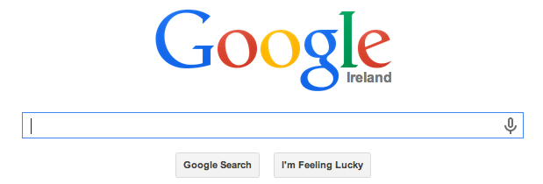
Getting more out of Google
Definitions – define:
Calculator – operation in search box
Unit converter – directly in search box
Notes:
ACTIVITY:
Use the following examples or use examples of your own. Give the group time to try each example.
Define: define: equilibrium (a definition will be displayed, complete with sound file. This can be particularly useful for students for whom English is not their first language). Sound files will not feature for phrases.
35*5 (while the answer will be displayed automatically in the search bar, by clicking enter, a scientific calculator, complete with the answer will be displayed).
convert 12 stone to kg/miles to kilometres, celsius to fahrenheit, euros to dollars.

Slide 34
Operators
Use ‘site:’ followed by a website name to confine your search to a given site
Use quotations marks “ “ around words to search for use of those words together
Use ‘-’ followed by a search term to exclude that term from the search
Use ‘…’ between parameters to return searches from that range
Notes:
Follow the notes on slide above with tasks to be completed. Follow instructions on screen to involve all participants in these tasks.
education site:rte.ie/news will confine results to rte.ie/news (useful when searching for current events, if you only want the Irish perspective)
“standardised testing”
taoiseach –Kenny we might use this example if looking for stories about the Taoiseach prior to Enda Kenny taking the position
ireland 1916..1922 Search for information about Ireland between the years 1916 and 1922

Slide 35
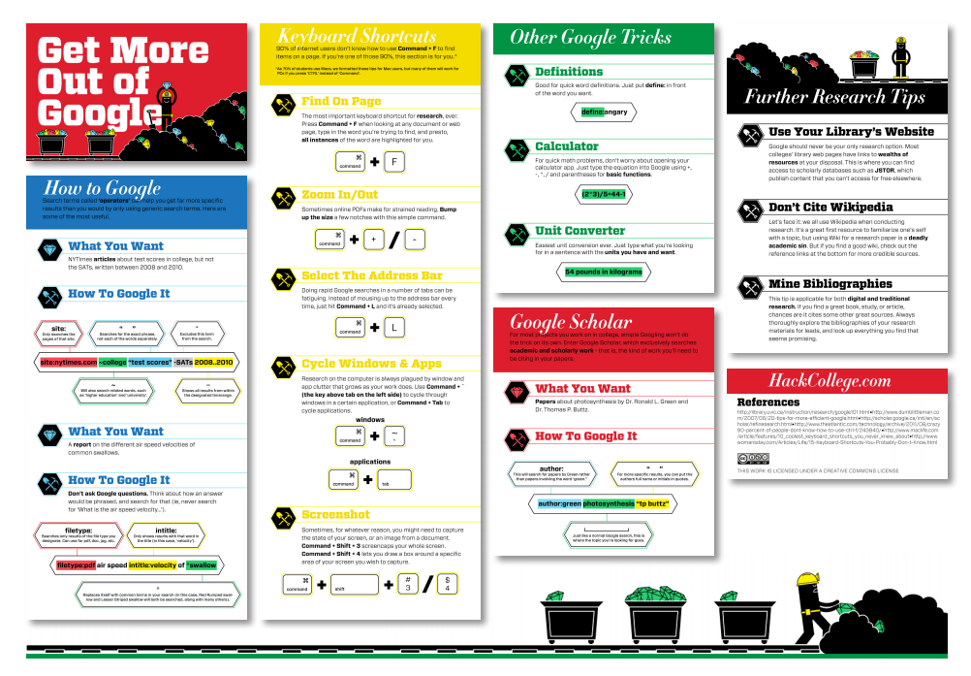
Source: https://www.flickr.com/photos/x1brett/6707250233
Creative Commons Licence: https://creativecommons.org/licenses/by/2.0/
Notes:
Participants may wish to display this infographic in their classroom to remind students of the search strategies useful when researching online.
Source: https://www.flickr.com/photos/x1brett/6707250233
Creative Commons Licence: https://creativecommons.org/licenses/by/2.0/

Slide 36
Group Reflection
Why are the skills of purposefully “finding and selecting and information” important and relevant for teachers nowadays?
How will you change the way you search for information online as a result of this workshop?
Which tools from this workshop would you now use in your own classroom?
Which of these tools would you recommend to a teaching colleague?
Notes:
Allow teachers time to reflect upon and discuss the points above.

